Slide 1
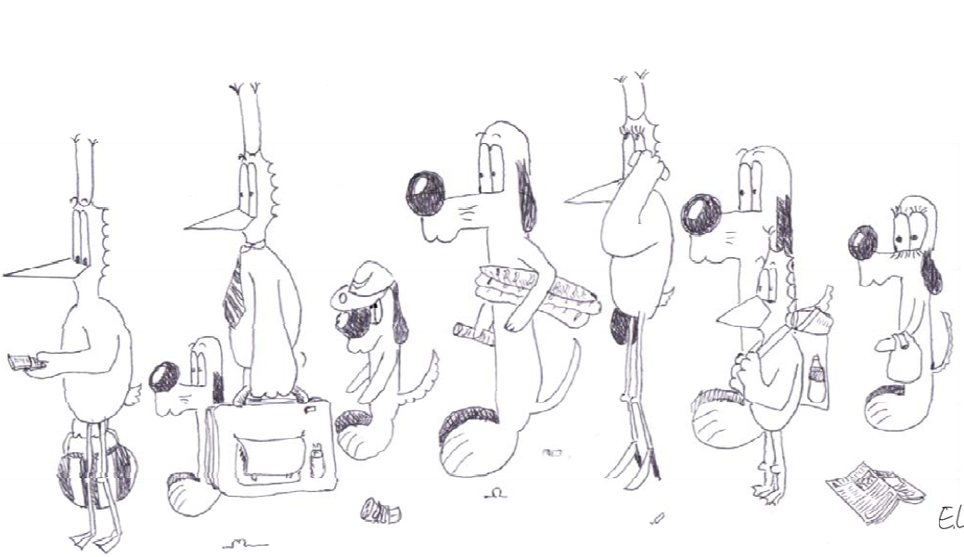
Queuing Theory For Dummies
Jean-Yves Le Boudec 2021

Slide 2
All You Need to Know About Queuing Theory
Queuing is essential to understand the behaviour of complex computer and communication systems
In depth analysis of queuing systems is hard
Fortunately, the most important results are easy
We will first study simple concepts

Slide 3
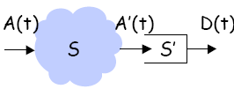
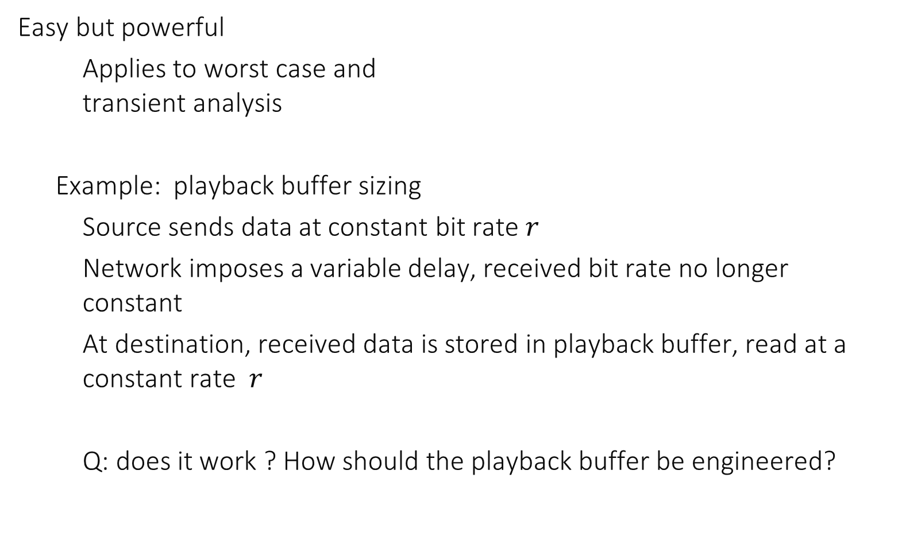
1. Deterministic Queuing
Easy but powerful
Applies to worst case and transient analysis
Example: playback buffer sizing
Source sends data at constant bit rate $r$
Network imposes a variable delay, received bit rate no longer constant
At destination, received data is stored in playback buffer, read at a constant rate $r$
Q: does it work ? How should the playback buffer be engineered?

Slide 4
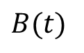
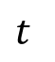
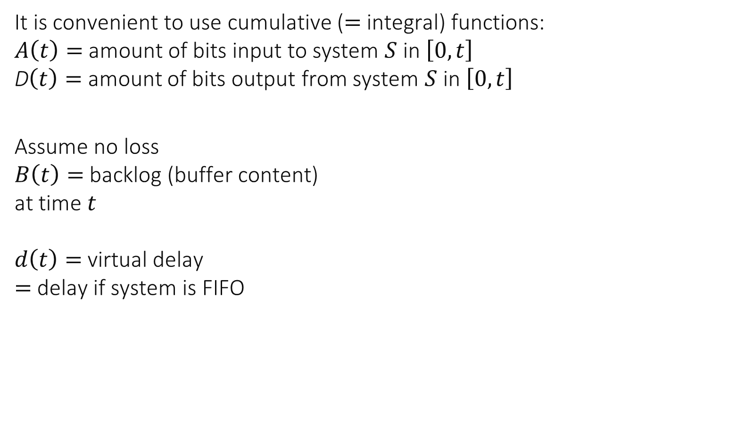
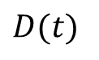
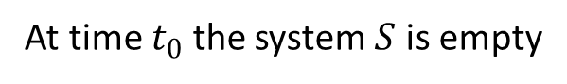
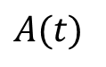
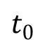
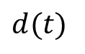
Cumulative Functions
It is convenient to use cumulative ($=$integral) functions: $A\left(t\right)=$ amount of bits input to system $S$ in $\left[0, t\right]$ D$\left(t\right)=$ amount of bits output from system $S$ in $\left[0, t\right]$
Assume no loss $B\left(t\right)=$ backlog (buffer content) at time $t$ $d\left(t\right)=$ virtual delay $=$ delay if system is FIFO
A(t)
D(t)
S
bits
$$A(t)$$
$$D(t)$$
$$d(t)$$
$$B(t)$$
$$t$$
$$t_{0}$$
time
At time $t_{0}$ the system $S$ is empty

Slide 5
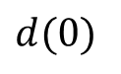
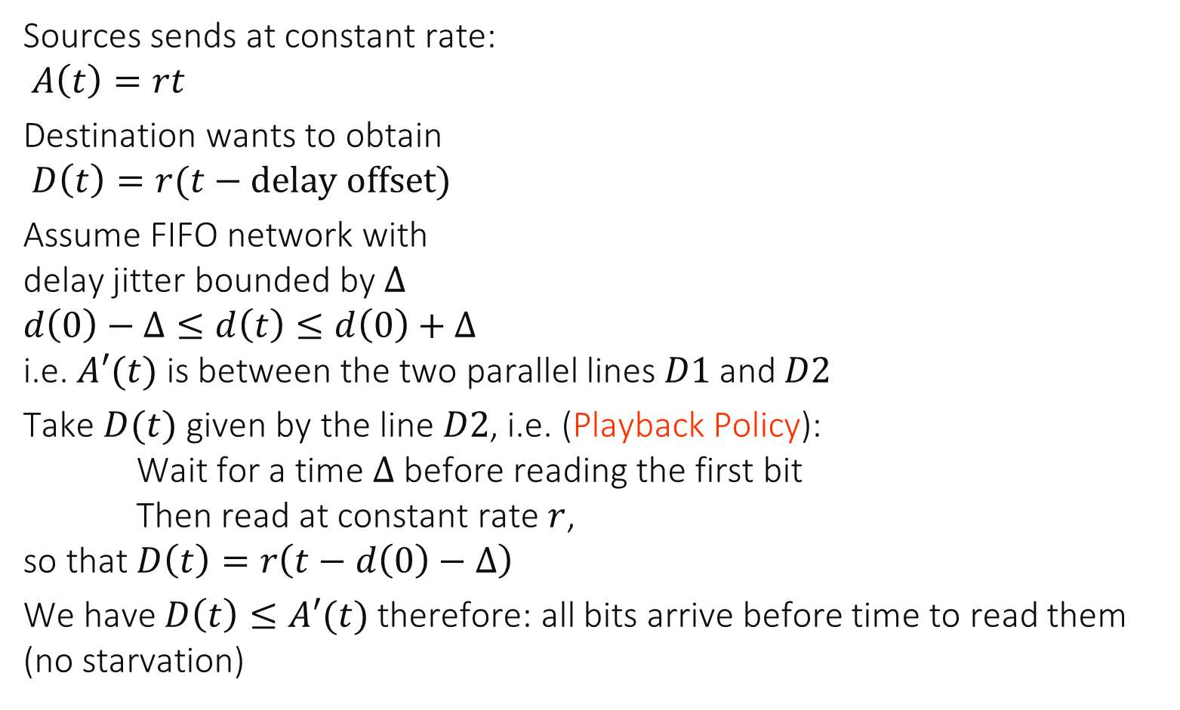
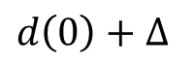
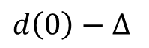
The playback buffer problem
Sources sends at constant rate: $A\left(t\right)=rt$
Destination wants to obtain $D\left(t\right)=r(t−delay offset)$
Assume FIFO network with delay jitter bounded by $Δ$ $d\left(0\right)−Δ≤d\left(t\right)≤d\left(0\right)+Δ$ i.e. $A′(t)$ is between the two parallel lines $D1$and $D2$
Take $D(t)$ given by the line $D2$, i.e. (Playback Policy): Wait for a time $Δ$ before reading the first bit Then read at constant rate $r$, so that $D\left(t\right)=r\left(t−d\left(0\right)−Δ\right)$
We have $D\left(t\right)≤A′(t)$ therefore: all bits arrive before time to read them (no starvation)
bits
A(t)
A’(t)
D(t)
d(t)
D1
D2
time
$$d\left(0\right)−Δ$$
$$d(0)$$
$$d\left(0\right)+Δ$$

Slide 6
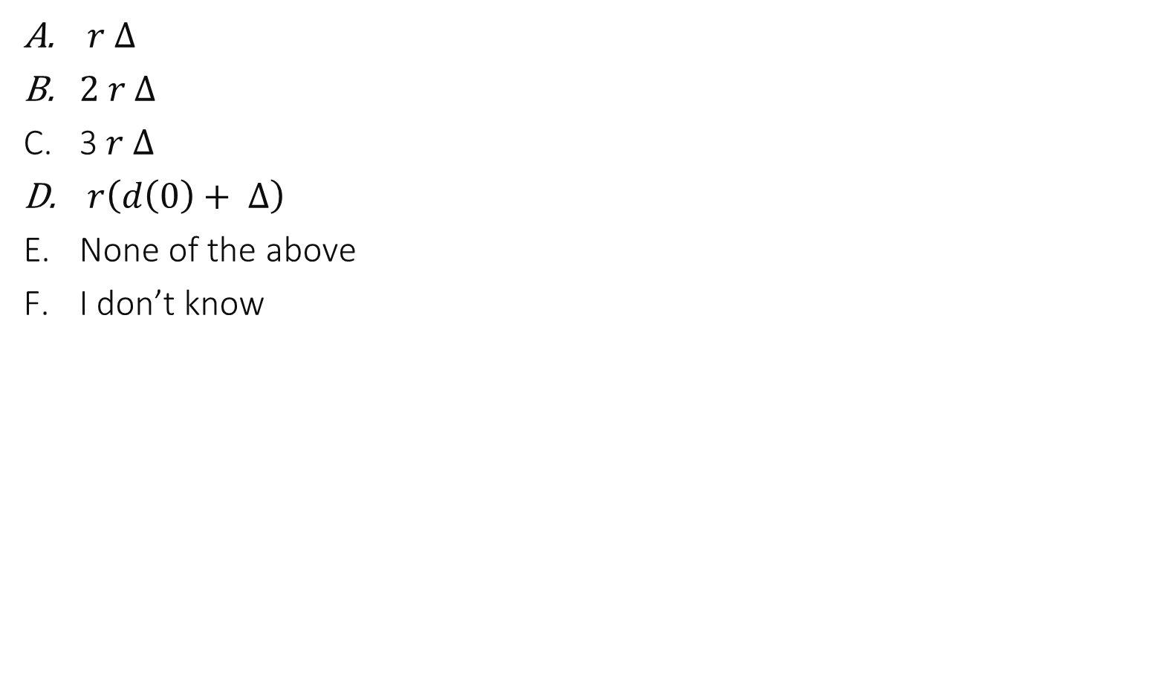
How large should the playback buffer be ?
$r Δ$
$2 r Δ$
3$r Δ$
$r\left(d\left(0\right)+ Δ\right)$
None of the above
I don’t know
bits
A(t)
A’(t)
D(t)
d(t)
D1
D2
time
$$d\left(0\right)−Δ$$
$$d(0)$$
$$d\left(0\right)+Δ$$

Slide 7
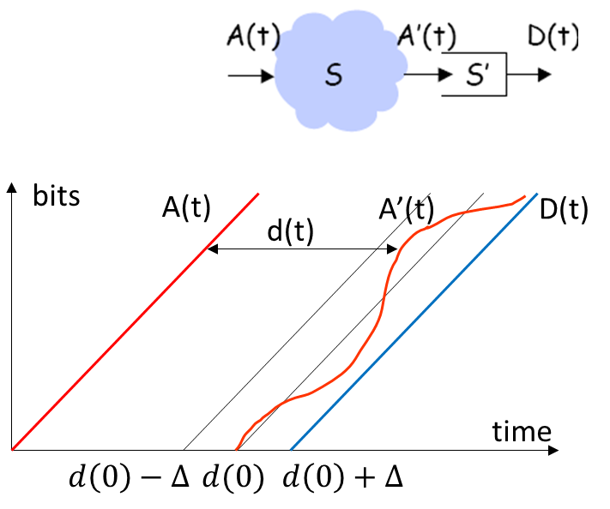
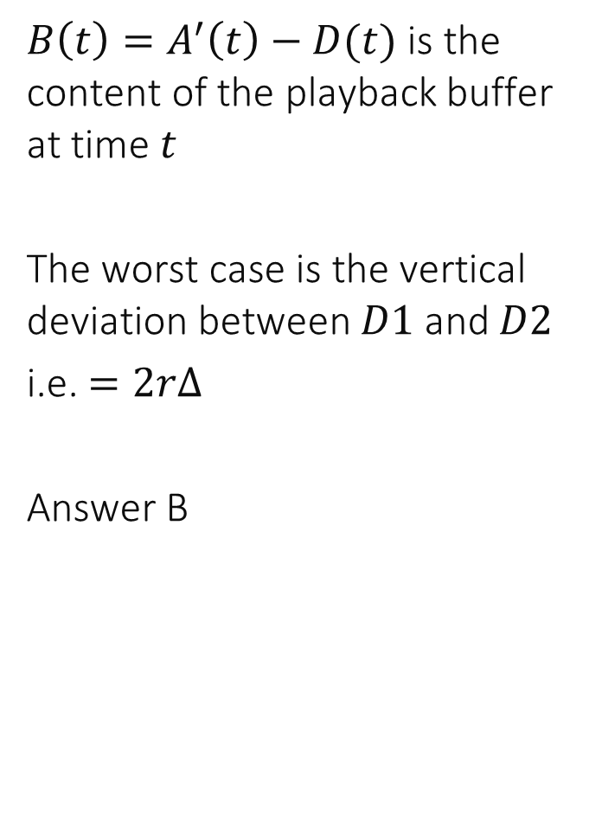
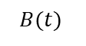
Solution
$B\left(t\right)=A^{′}\left(t\right)−D(t)$ is the content of the playback buffer at time $t$
The worst case is the vertical deviation between $D1$ and $D2$
i.e. $=2rΔ$
Answer B
$$B(t)$$
D1
D2

Slide 8
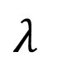
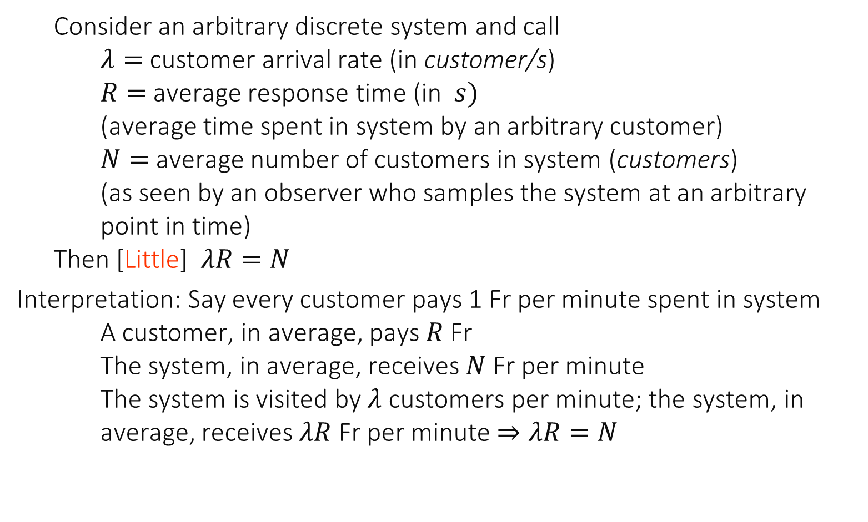
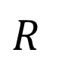
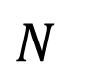
2. Operational Laws Little’s law
$$λ$$
$$N$$
Consider an arbitrary discrete system and call $λ=$ customer arrival rate (in customer/s) $R=$ average response time (in $s)$ (average time spent in system by an arbitrary customer) $N=$ average number of customers in system (customers) (as seen by an observer who samples the system at an arbitrary point in time) Then [Little] $λR=N$
Interpretation: Say every customer pays 1 Fr per minute spent in system A customer, in average, pays $R$ Fr The system, in average, receives $N$ Fr per minute The system is visited by $λ$ customers per minute; the system, in average, receives $λR$ Fr per minute $⇒λR=N$
$$R$$

Slide 9
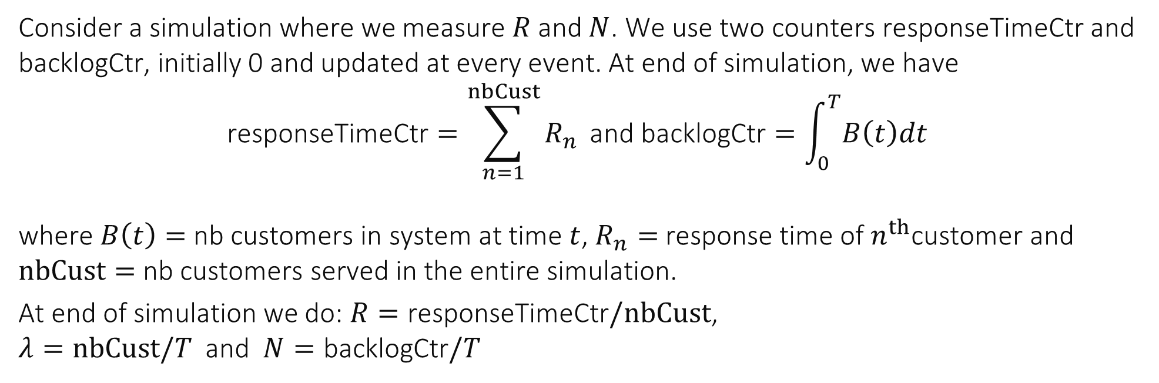
Little’s law in a simulation
$$B(t_{2}^{−})$$
$$R_{1}$$
$$B(t)$$
$$B(t_{2}^{+})$$
$$t_{1}$$
$$t_{2}$$
Consider a simulation where we measure $R$ and $N$. We use two counters responseTimeCtr and backlogCtr, initially 0 and updated at every event. At end of simulation, we have $$\text{responseTimeCtr}=\sum_{n=1}^{nbCust}{R_{n}} \text{and} \text{b}\text{acklogCtr}=\int_{0}^{T}{B\left(t\right)dt}$$ where $B\left(t\right)=$ nb customers in system at time $t$, $R_{n}=$ response time of $n^{th}$customer and $nbCust=$ nb customers served in the entire simulation.
At end of simulation we do: $R=\text{responseTimeCtr}/nbCust$, $λ=nbCust/T$ and $N=\text{backlogCtr}/T$

Slide 10
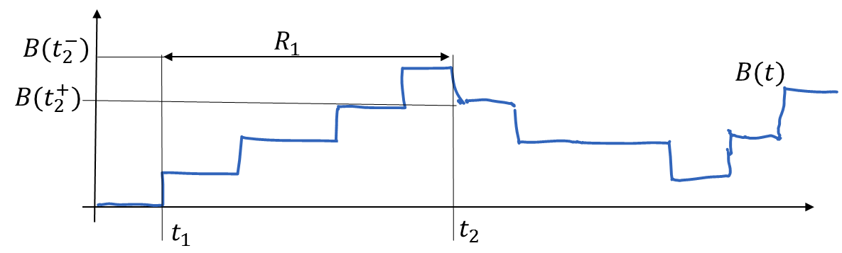
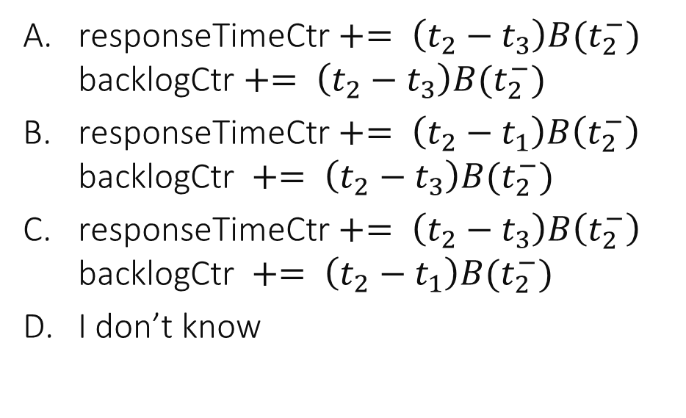
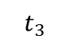
How is each counter updated at time $t_{2}$?
$$t_{3}$$
responseTimeCtr $+= \left(t_{2}−t_{3}\right)B(t_{2}^{−})$ backlogCtr $+= \left(t_{2}−t_{3}\right)B(t_{2}^{−})$
responseTimeCtr $+= \left(t_{2}−t_{1}\right)B\left(t_{2}^{−}\right)$ $\text{backlog}\text{Ctr} += \left(t_{2}−t_{3}\right)B(t_{2}^{−})$
responseTimeCtr $+= \left(t_{2}−t_{3}\right)B\left(t_{2}^{−}\right)$ $\text{backlog}\text{Ctr} += \left(t_{2}−t_{1}\right)B(t_{2}^{−})$
I don’t know

Slide 11

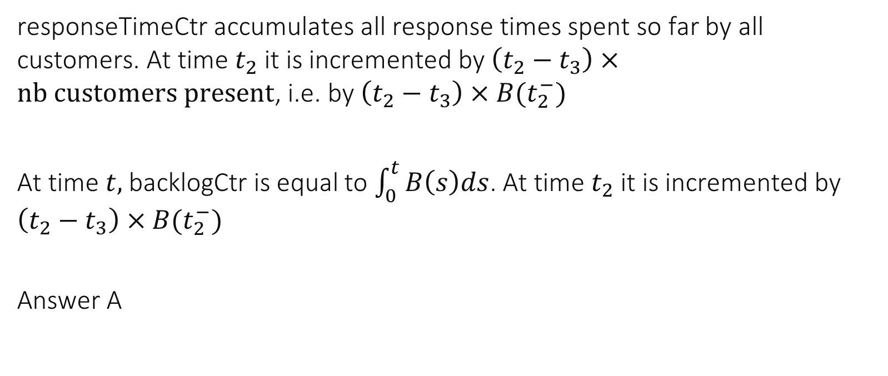
responseTimeCtr accumulates all response times spent so far by all customers. At time $t_{2}$ it is incremented by $\left(t_{2}−t_{3}\right)×nb customers present$, i.e. by $\left(t_{2}−t_{3}\right)×B(t_{2}^{−})$
At time $t,$backlogCtr is equal to $\int_{0}^{t}{B\left(s\right)ds}$. At time $t_{2}$ it is incremented by $\left(t_{2}−t_{3}\right)×B(t_{2}^{−})$
Answer A

Slide 12
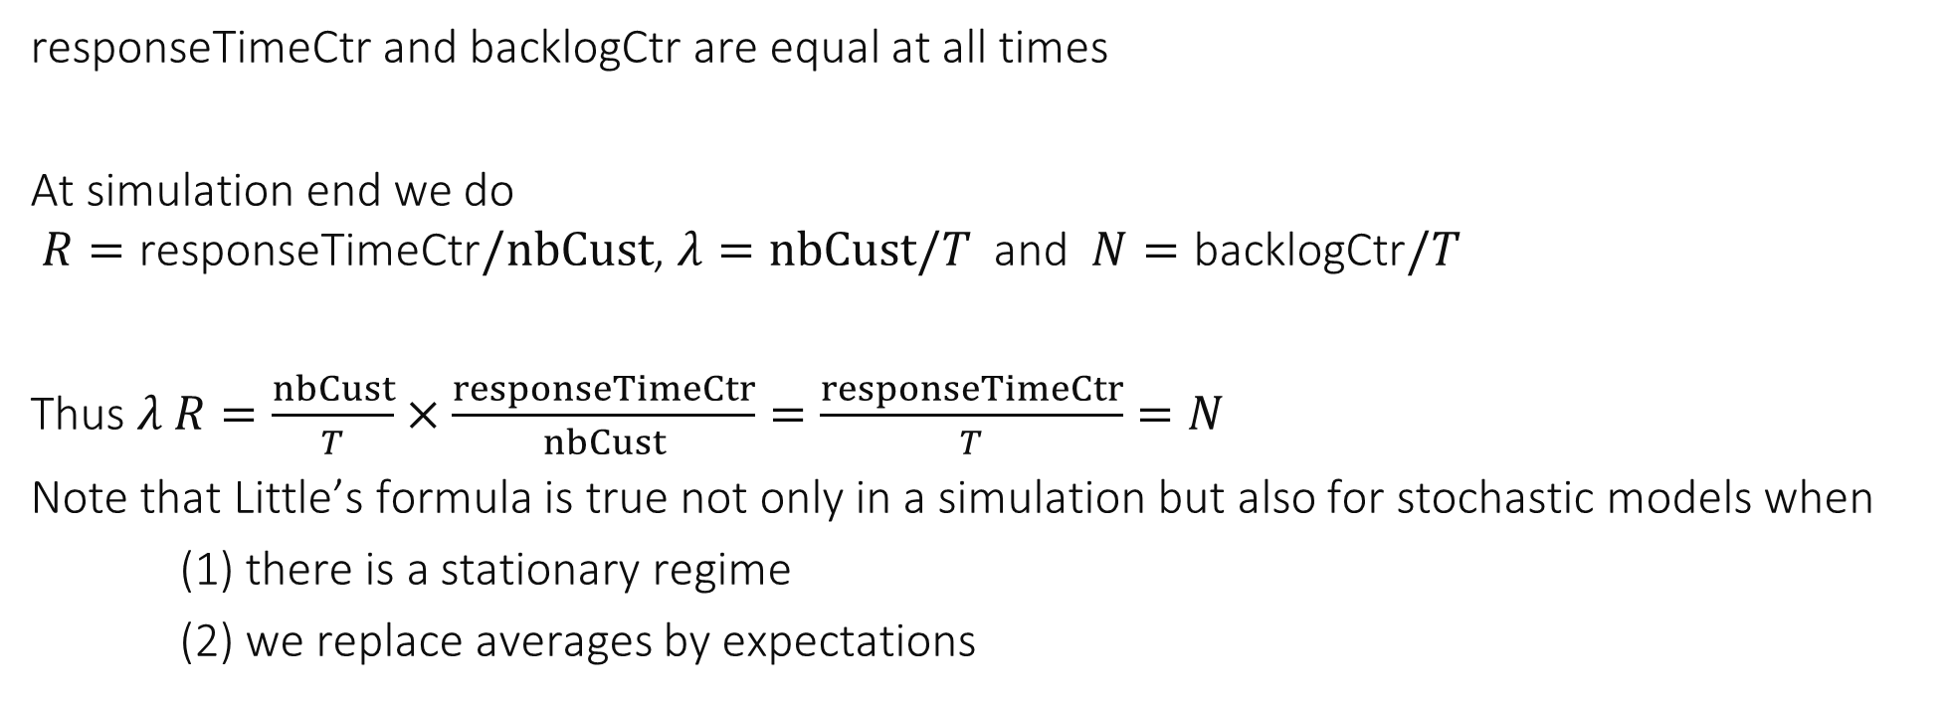
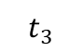
Proof of Little’s Formula
$$t_{3}$$
responseTimeCtr and backlogCtr are equal at all times
At simulation end we do $R=\text{responseTimeCtr}/nbCust$, $λ=nbCust/T$ and $N=\text{backlogCtr}/T$
Thus $λ R=\frac{nbCust}{T}×\frac{responseTimeCtr}{nbCust}=\frac{responseTimeCtr}{T}=N$
Note that Little’s formula is true not only in a simulation but also for stochastic models when
(1) there is a stationary regime
(2) we replace averages by expectations

Slide 13
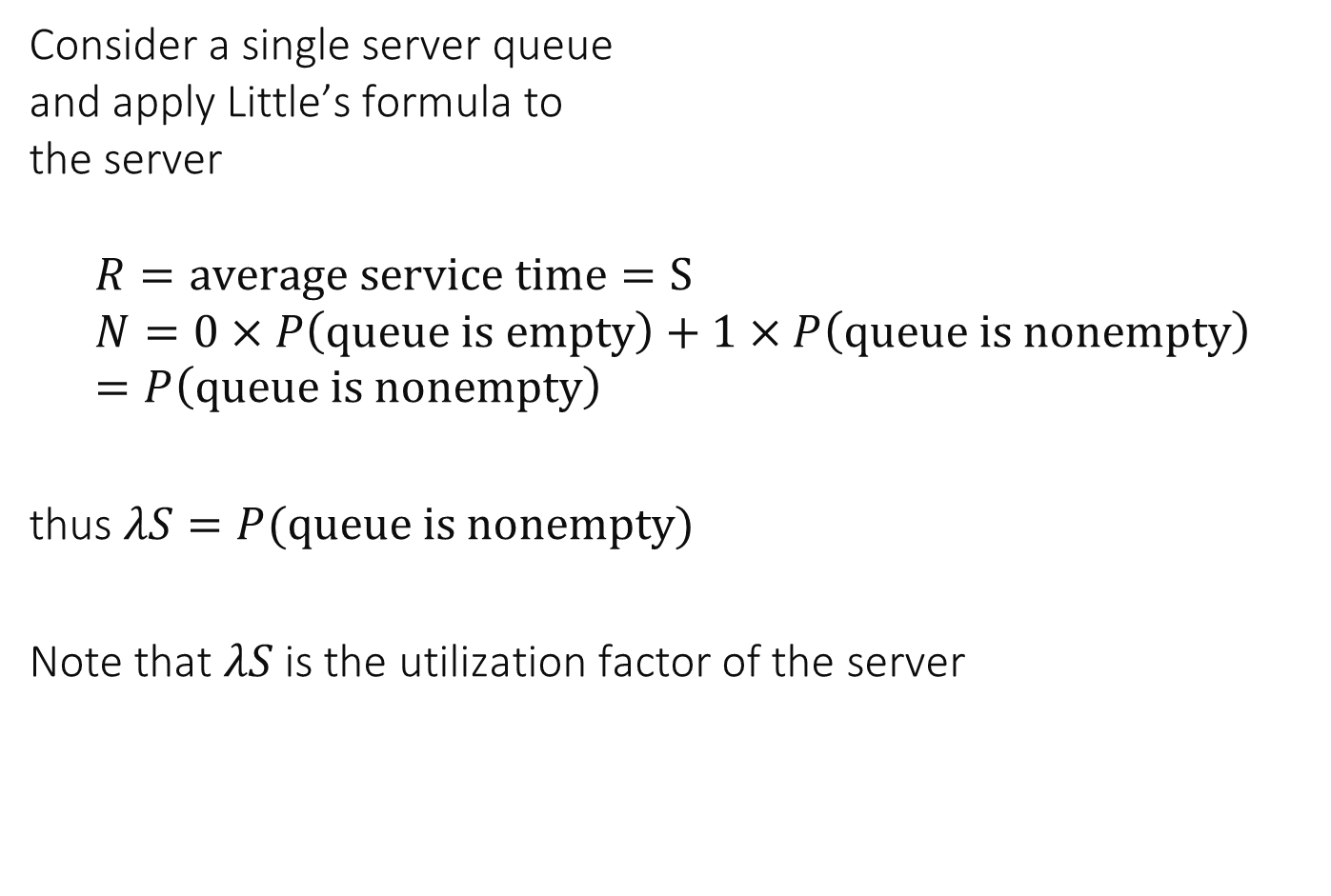
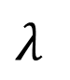
Utilization Law
Consider a single server queue and apply Little’s formula to the server $$R=average service time=S \\ N=0×P\left(queue is empty\right)+1×P\left(queue is nonempty\right) \\ =P\left(queue is nonempty\right)$$
thus $λS=P(queue is nonempty)$
Note that $λS$is the utilization factor of the server
$$λ$$

Slide 14
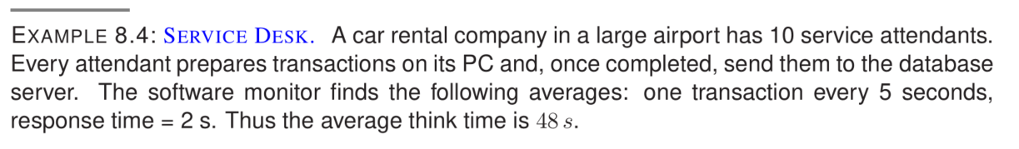
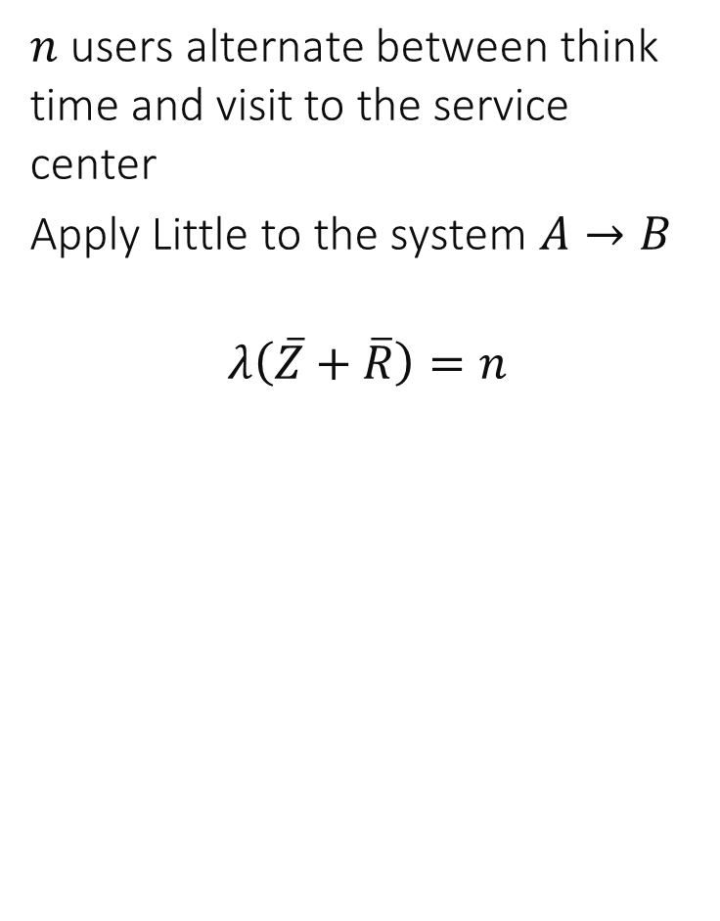
The Interactive User Model
$$Z$$
$$R$$
$n$ users alternate between think time and visit to the service center
Apply Little to the system $A→B$
$$λ\left(\overline{Z}+\overline{R}\right)=n$$
$$λ$$
Service
Center
A
B
$n$ users

Slide 15
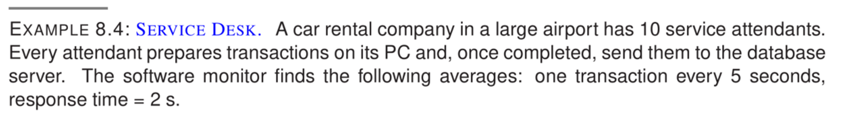
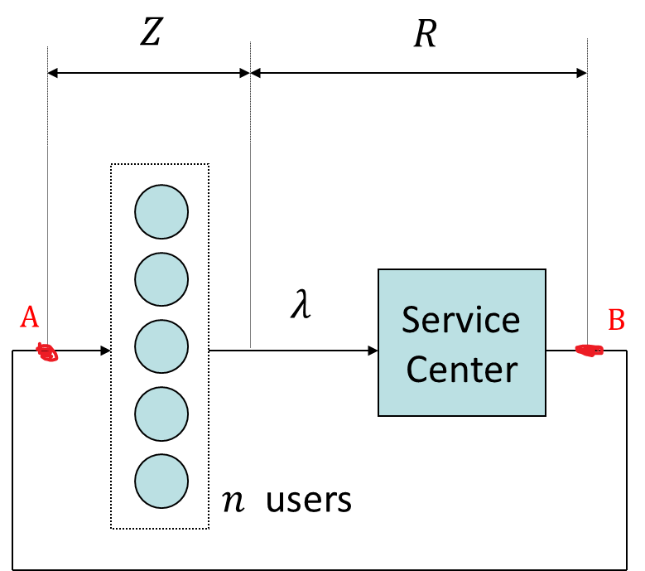
What is the average think time ?
3 s
6 s
12 s
24 s
48 s
I don’t know

Slide 16
Solution
Apply the interactive user model
$$λ\left(\overline{Z}+\overline{R}\right)=n \\ \frac{1}{5}\left(\overline{Z}+2\right)=10$$
$$\overline{Z}=48 s$$
Answer E

Slide 17
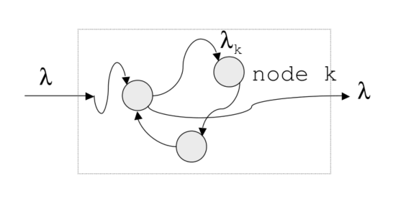
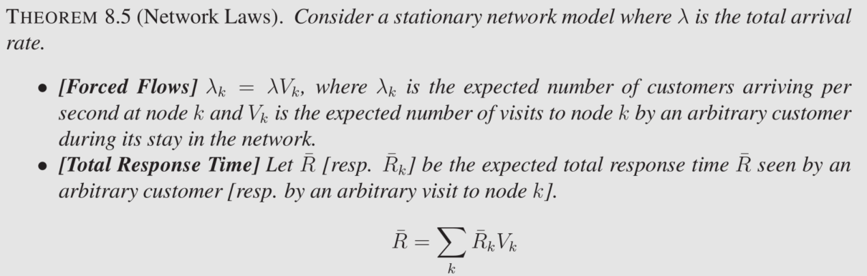
Network Laws

Slide 18
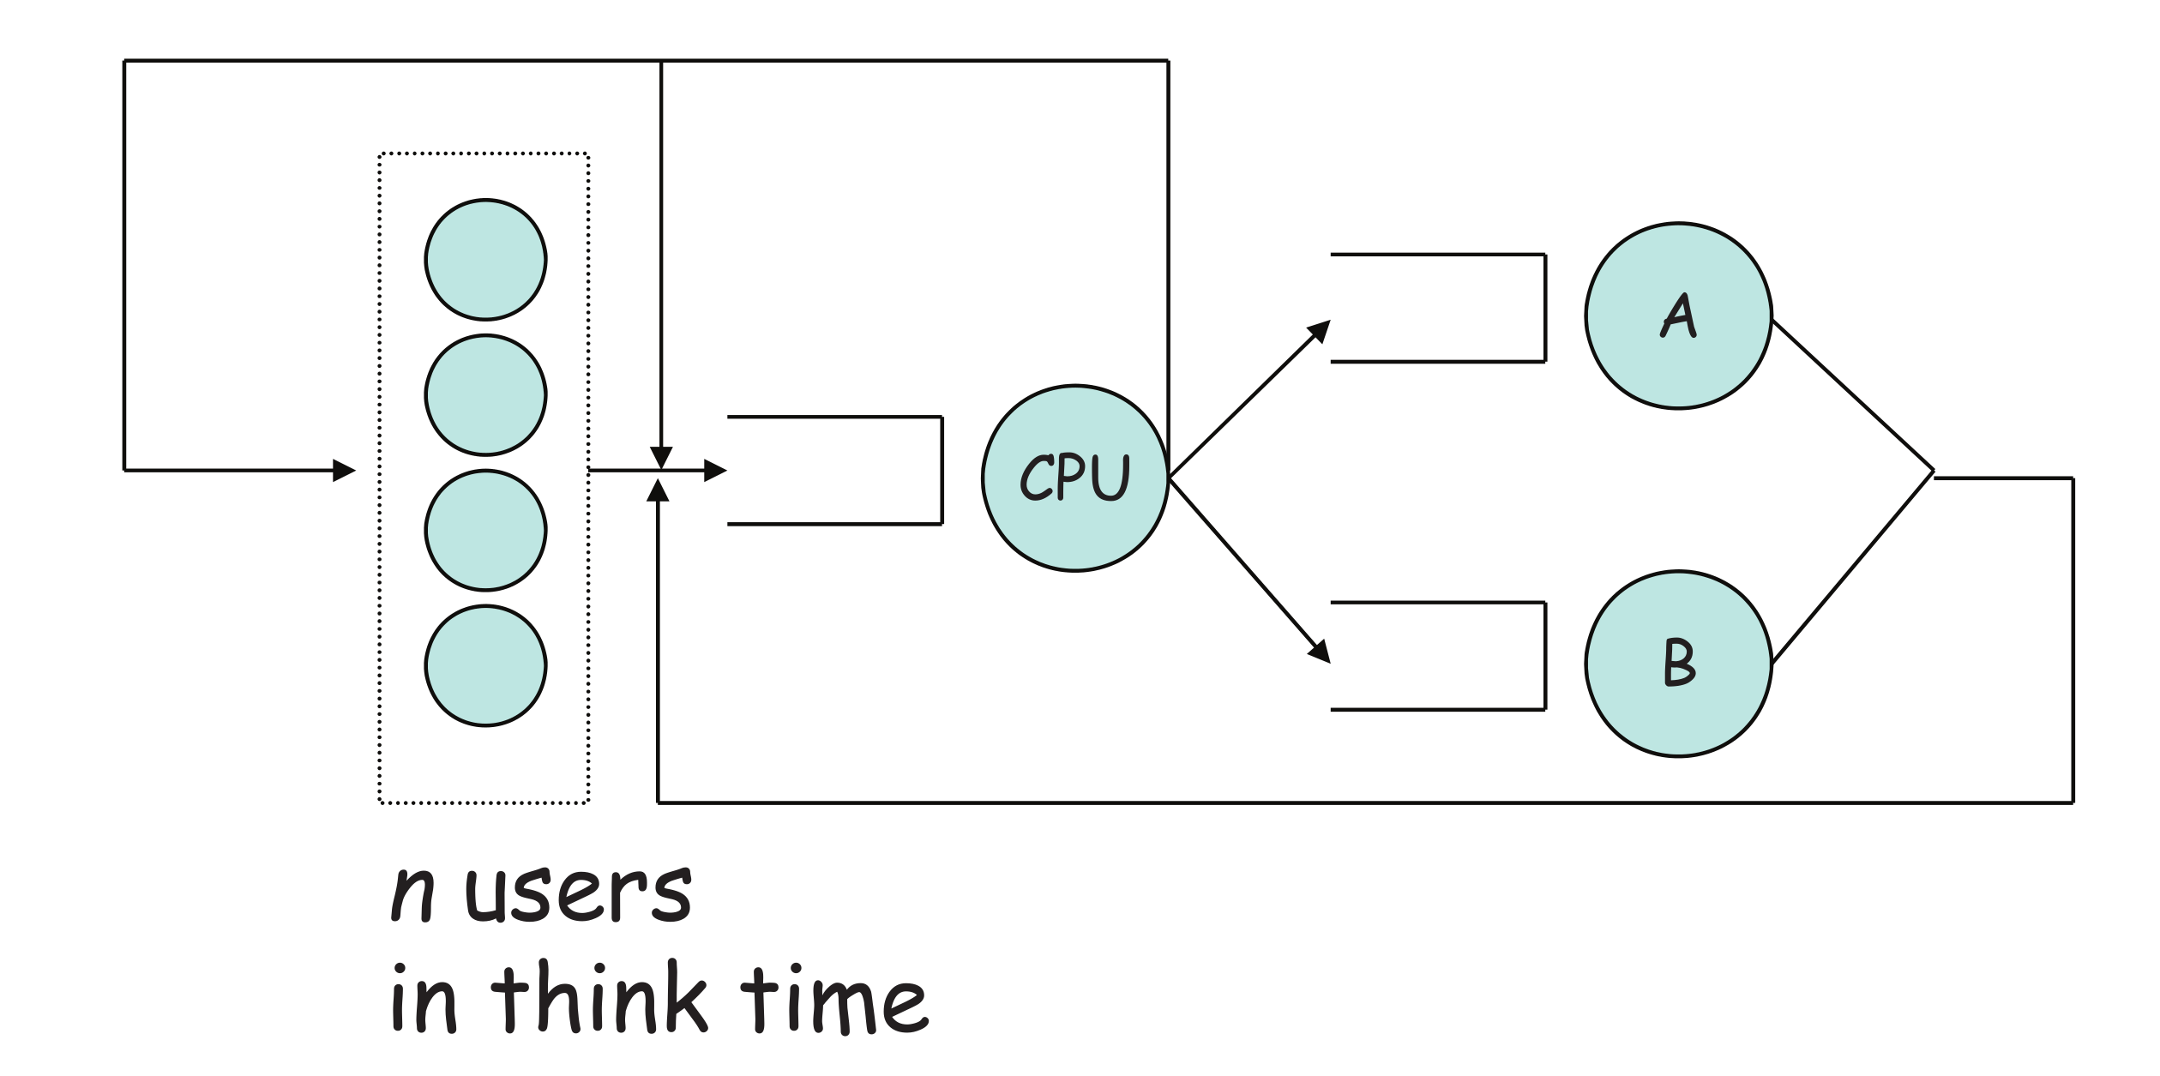
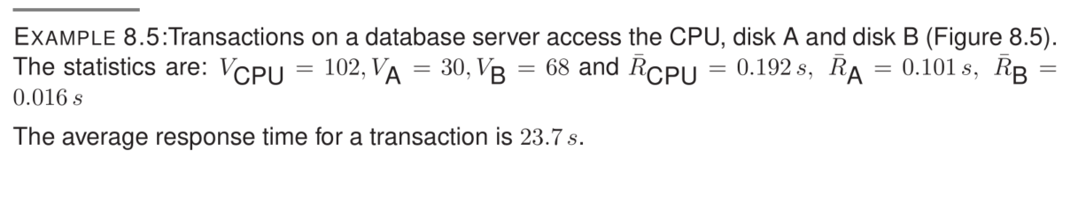
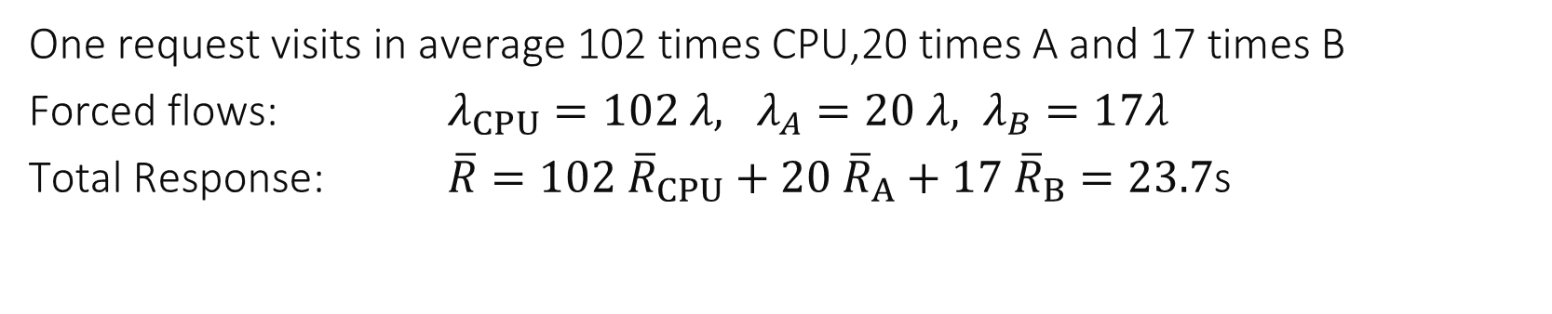
Example
One request visits in average 102 times CPU,20 times A and 17 times B
Forced flows: $λ_{CPU}=102 λ, λ_{A}=20 λ, λ_{B}=17λ$
Total Response: $\overline{R}=102 {\overline{R}}_{CPU}+20 {\overline{R}}_{A}+17 {\overline{R}}_{B}=23.7$s

Slide 19
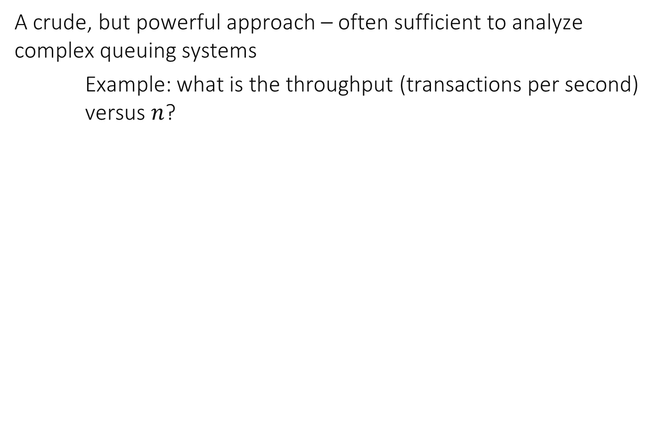
Bottleneck Analysis
A crude, but powerful approach – often sufficient to analyze complex queuing systems
Example: what is the throughput (transactions per second) versus $n$?

Slide 20
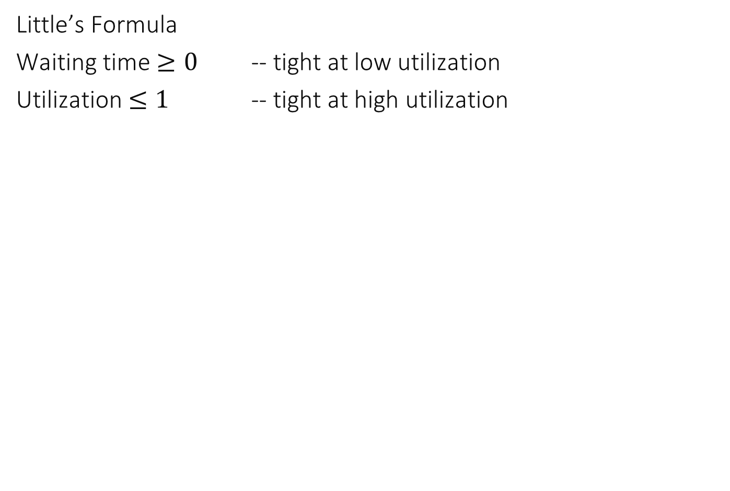
Principles of Bottleneck Analysis
Little’s Formula
Waiting time $≥0$ -- tight at low utilization
Utilization $≤1$ -- tight at high utilization

Slide 21
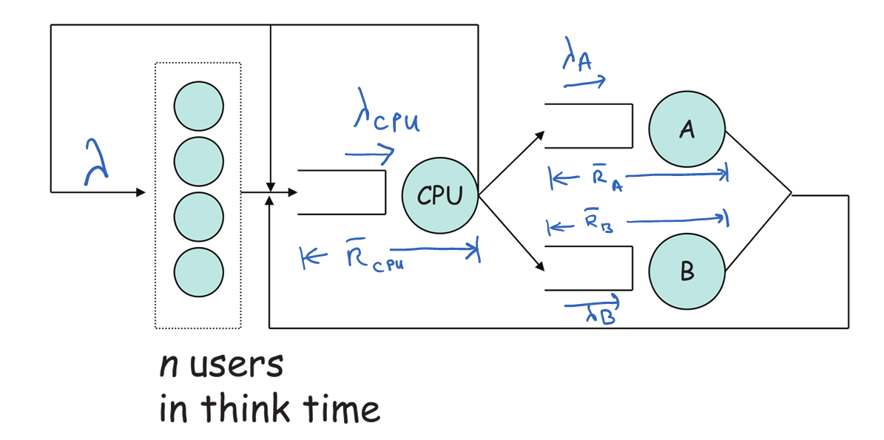
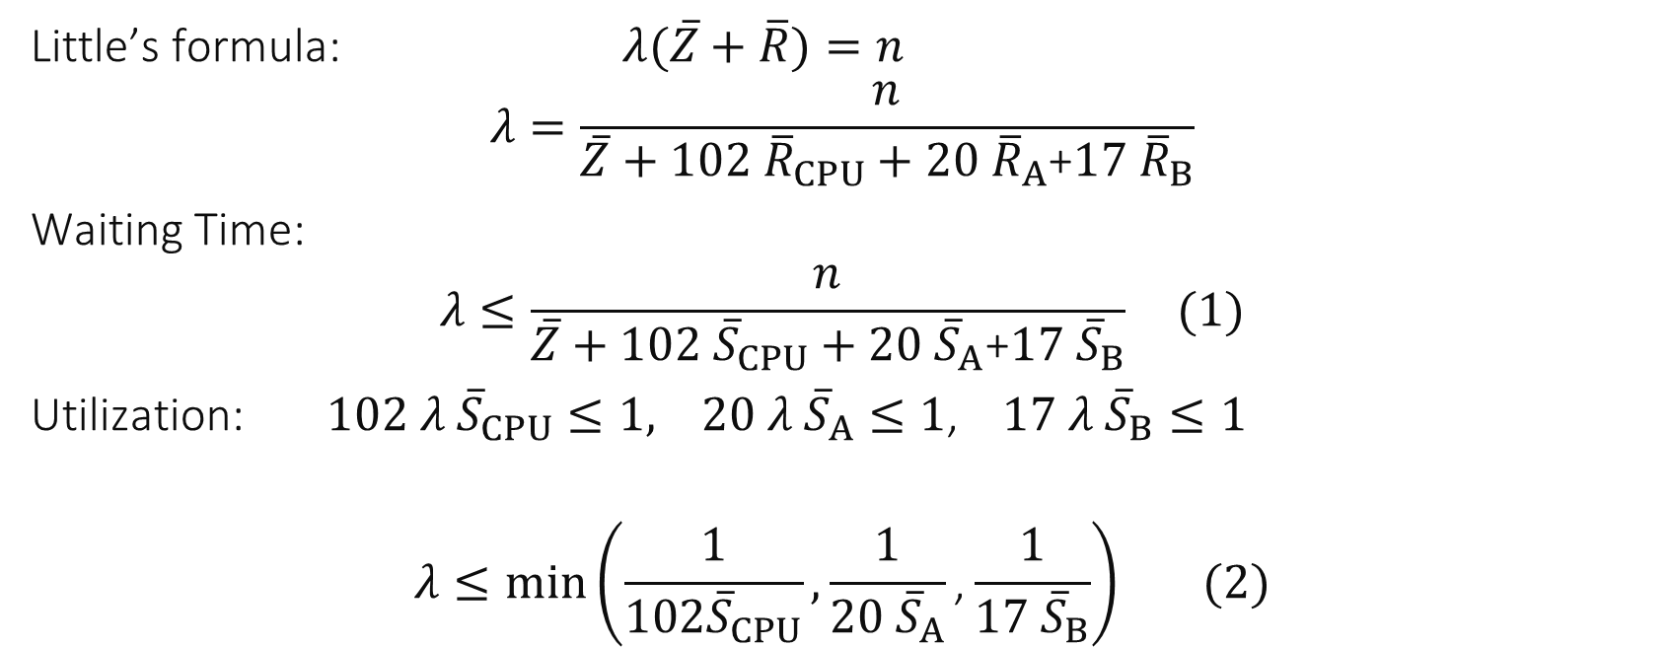

Little’s formula: $λ(\overline{Z}+\overline{R})=n$
$$λ=\frac{n}{\overline{Z}+102 {\overline{R}}_{CPU}+20 {\overline{R}}_{A}\text{+}17 {\overline{R}}_{B}}$$
Waiting Time:
$$λ≤\frac{n}{\overline{Z}+102 {\overline{S}}_{CPU}+20 {\overline{S}}_{A}\text{+}17 {\overline{S}}_{B}} (1)$$
Utilization: $102 λ {\overline{S}}_{CPU}≤1, 20 λ {\overline{S}}_{A}≤1$, $17 λ {\overline{S}}_{B}≤1$
$$λ≤min\left(\frac{1}{102{\overline{S}}_{CPU}},\frac{1}{20 {\overline{S}}_{A}}\text{,}\frac{1}{17 {\overline{S}}_{B}}\right) (2)$$

Slide 22
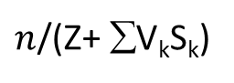
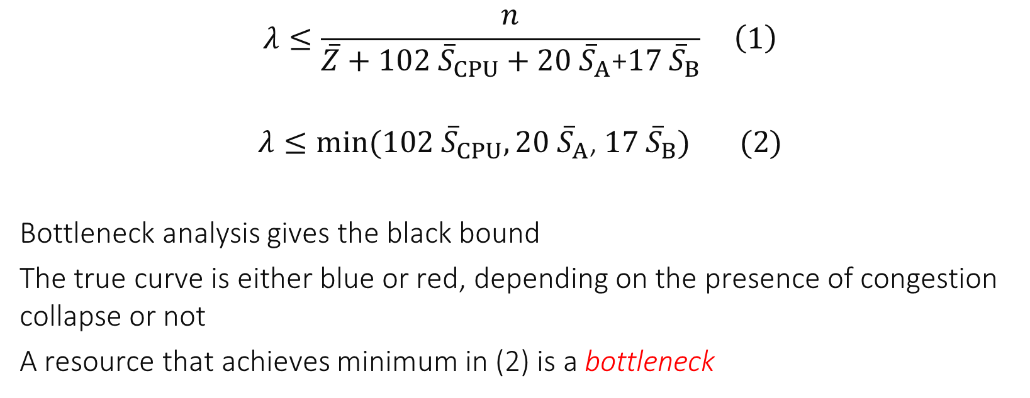
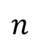
throughput
$n$/(Z+ ∑V_{k}S_{k})
1/(V_{A} S_{A})
1/(V_{CPU} S_{CPU})
(2)
(1)
Without congestion collapse
With congestion collapse
$$n$$
$$λ≤\frac{n}{\overline{Z}+102 {\overline{S}}_{CPU}+20 {\overline{S}}_{A}\text{+}17 {\overline{S}}_{B}} \left(1\right)$$
$$λ≤min(102 {\overline{S}}_{CPU}, 20 {\overline{S}}_{A}\text{, }17 {\overline{S}}_{B}) (2)$$
Bottleneck analysis gives the black bound
The true curve is either blue or red, depending on the presence of congestion collapse or not
A resource that achieves minimum in (2) is a bottleneck

Slide 23
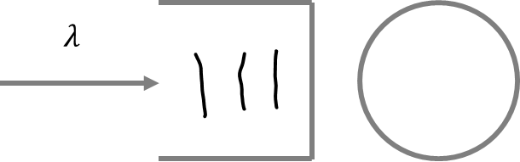
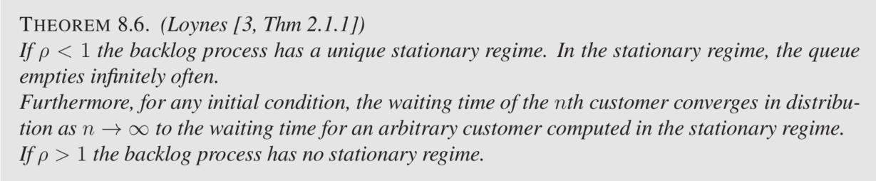

3. Single Server Queue Stability
Recall that $ρ=λ×average service time$ $ρ<1⇒$ system has a stationary regime (and converges to it)
$ρ>1⇒$ system has no stationary regime
If $ρ=1$ the theorem says nothing – both cases are possible
Loynes’ theorem does not assume any independence anywhere

Slide 24




Example: M/GI/1 queue
1 server
$M=$markov $=$Poisson arrival process
Times between arrivals are exp($λ$) where $λ$ is the arrival rate
memoryless: an arrival in $\left[t, t+dt\right]$ is independent of the past and has probability $λ dt$
$GI =$General Independent i.e. service times are iid with a finite variance and independent of the arrival process
with $ρ=λ\overline{S}$
Avg number in waiting room
Avg waiting time

Slide 25



The formula $\overline{N}={\overline{N}}_{w}+ρ$ is true …
$$λ$$
$$\overline{S}$$
$$ρ=λ\overline{S}$$
For the M/GI/1 queue but not for all stable single server queues
For all single server queues with Poisson arrivals but not for all stable single server queues
For all single stable server queues
I don’t know

Slide 26


For any queue, at any time $t$: nb in system $=$ nb in waiting room + nb in service
For a stable queue:
$$\overline{N}={\overline{N}}_{w}+average number in service$$
For a stable single server queue (Utilization law):
$$average number in service=λ\overline{S}=ρ$$
Thus $\overline{N}={\overline{N}}_{w}+ρ$
Answer C

Slide 27







Other explicit formulas
GI+ Exponential service times
Constant service times
Total capacity $K$customers in system

Slide 28




$$ρ=\frac{λ\overline{S}}{s}$$
$s$ servers

Slide 29


Non Linearity of Response Time

Slide 30


Which curve is for which distribution of service time?
Top =1 Middle =2 Bottom =3
1,3,2
2,1,3
2,3,1
3,1,2
3,2,1
I don’t know
M/GI/1 queue with same mean service time
but with different second moment of service time
$σ_{S}=0$ (constant service time)
$σ_{S}=\overline{S} \text{ (}\text{e}\text{.}\text{g}\text{. }\text{exponential}\text{)}$
$σ_{S}=2\overline{S}$

Slide 31
Solution
By the Pollaczek-Kintchine formula, the mean number of customers increases with $σ$:
Answer F
More variable service times increases waiting time
But capacity is independent ($ρ=\overline{λ}S<1$ depends only on mean service time)

Slide 32

Optimal Sharing
Assume Poisson arrivals and exponential service times. Compare the two in terms of
Response time
Capacity

Slide 33

Which curve is for system 1 ?
The top curve
The bottom curve
I don’t know

Slide 34
Solution
We expect that system 1 has a better response time because the 2 servers are always available – in contrast, with system 2 it may be that one server is idle whereas the other waiting room is not empty.
Answer B

Slide 35

Which system has the larger capacity ? (i.e. the max$λ$ for which system is stable ?)
System 1
System 2
Both have the same
I don’t know

Slide 36
Solution
System 1 is an M/M/2 queue and is stable for
$$\frac{2λ}{2\overline{S} }<1$$
System 1 is made of two M/M/1 queues, each of them is stable for
$$\frac{λ}{\overline{S} }<1$$
i.e. both have the same stability condition.
Answer C

Slide 37



For an M/M/1 queue, what is the expected response time for a customer with service time $x$ ?
$\overline{S}\left(1−ρ −x \right)$
$x+\frac{ρ \overline{S}}{1−ρ}$
$\frac{xρ}{1−ρ}$
$\frac{xρ^{2}}{1−ρ}$
I don’t know

Slide 38
Solution
The response time is equal to service time + waiting time; the answer is therefore
$$x+\overline{W}=x+\frac{ρ \overline{S}}{1−ρ}$$
Answer B

Slide 39

The Processor Sharing Queue M/GI/1/PS
All queues seen so far are FIFO (a notation such as M/M/1 assumes FIFO by default)
The processor sharing queue M/GI/1/PS is a single server non FIFO queue where the server is equally shared between all customers present.
Models: processors, network links.
By Loynes’ theorem, stability is for $ρ<1$
The number of customers in system has a geometric distribution $P\left(N\left(t\right)=k\right)=\left(1−ρ\right)ρ^{k}$ independent of distribution of service time
Egalitarian property: $$E\left( response time \right|service time=x)=\frac{x}{1−ρ}$$

Slide 40


Fairness of PS: Expected response time given service time is $x$ M/M/1/PS versus M/M/1/FIFO

Slide 41


4. A Case Study
Impact of capacity increase ?
Optimal Capacity ?

Slide 42

Methodology
Goal: evaluate impact of doubling capacity of skilift
Factors: $c=$ capacity of ski-lift in people / sec
Metric : waiting time at the lift
Load
Model 1: arrival in burst
Model 2: peak hour stationary regime

Slide 43


4.1. Deterministic Analysis
people
d_{max}
d_{max}/2
Arrival curve
Doubling capacity $⇒$ max delay is divided by 2
And same for average delay
B
A(t)
b(t)=2ct
Service curve
b₀(t)=ct
time

Slide 44


4.2 Single Queue Analysis
Assume no feedback in the system; we have an M/GI/1 queue
Non linearity of response time $⇒$ we need to know where we were on the curve before doubling capacity
We were probably close to asymptote; doubling the capacity $⇒$
very large reduction of waiting time, more than by a factor of 2

Slide 45


4.3 Operational Analysis
A refined model, with circulating users;
Gate has a capacity $c$ customers/sec;
e.g. Gate has $K$ slots, time to go through gate $\overline{G}$, $c=\frac{K}{\overline{G}}$
$λ, \overline{W}$ to be determined
$c,\overline{S}, \overline{Z},\overline{N}$ known

Slide 46





Bottleneck Analysis
Little: $λ\left(\overline{W}+\overline{S}+\overline{Z}\right)=\overline{N}$ $$⇒ \overline{W}=\frac{\overline{N}}{λ}−\overline{S}−\overline{Z}$$
Waiting Time: $\overline{W}≥0$
Utilization: $λ\overline{G}≤K$ i.e. $λ≤c$
$$⇒ \overline{W}≥\frac{\overline{N}}{c}−\overline{S}−\overline{Z} and \overline{W}≥0$$
waiting time
$$\frac{\overline{S}+\overline{Z}}{N}$$
$$1/c$$
$$−Z$$

Slide 47

Exact solution using queuing network theory

Slide 48

What is the impact of doubling the capacity on the average waiting time ?
Reduction by more than 2
Reduction by less than 2
No reduction
I don’t know
Average waiting time
1/c

Slide 49
Solution
The curve $\frac{1}{c}↦f\left(\frac{1}{c}\right)=average waiting time$is convex and $f\left(0\right)=0$
Thus $f\left(\frac{1}{2c}\right)=f\left(\frac{1}{2}×0+\frac{1}{2}×\frac{1}{c}\right)≤\frac{1}{2}f\left(0\right)+\frac{1}{2}f\left(\frac{1}{c}\right)$ $$f\left(\frac{1}{2c}\right)≤\frac{1}{2}f\left(\frac{1}{c}\right)$$
In other words, it reduces by more than 2
Answer A

Slide 50




Critical Capacity
The curve shows that there is a critical capacity $c^{∗}$, such that above $c^{∗}$ the waiting time is very small, below $c^{∗}$ it increases linearly
The system should be designed to operate with $c≈c^{∗}$
Bottleneck analysis gives $c^{∗}≈\frac{N}{\overline{S}+\overline{Z} }$ where $N$ is the average number of skiers in domain and $Z$ is the average time on slope
$$\frac{1}{c^{∗}}$$

Slide 51
Conclusions
Queuing is essential in communication and information systems
M/M/1, M/GI/1, M/GI/1/PS and variants have closed forms
Little’s formula and other operational laws are powerful tools, not just for queuing systems
Bottleneck analysis and worst case analysis are usually very simple and often give good insights

